Slide 1
CSG2A3 ALGORITMA dan STRUKTUR DATA
Stack
Linked List Implementation

Slide 2
Stack
Linked list Implementation to a real case
Arranged in LIFO (Last In First Out)
The most recently inserted element in the stack is the only one that can be retrieved or removed
Thus, if you wish to retrieve an element inserted long ago, you must first remove all the elements that were inserted after the desired one

Slide 3
Stack – Real Life Example
Stack of books
Pile of dinner plates
When you remove a plate from the pile, you take the plate on the top of the pile.
If you want the plate at the bottom of the pile, you must remove all the plates on top of it to reach it

Slide 4
Stack - application related to computer science
Execution stack program
Evaluating expressions
Remembering partially completed tasks, and
Undoing (backtracking from) an action

Slide 5
Stack Definition
Stack is a linear linked list which:
Recognized only the top element (TOP)
Rule insertion and deletion of elements :
Insert and deletion always on top element

Slide 6
Stack Simulation
TOP
TOP
TOP
TOP

Slide 7
Stack – in summary
Single Linked list that only has operations
Insert first → push
Delete first → pop
First (L) replaced by TOP (S).

Slide 8
ADT Stack Element
Type infotype : integer
Type address : pointer to ElmStack
Type ElmStack <
info : infotype
next : address
>
Type Stack: < Top: address >
INFO
NEXT
ElmStack
Top
S

Slide 9
Traversal on Stack
In the stack traversal operation is rarely done, because it is precisely the uniqueness of stack operation that only involves elements of TOP.
However, if needed traversal, for example, to print the contents of the stack, then the stack traversal scheme is exactly the same as the usual linear list traversal scheme

Slide 10
Primitive Operation on Stack
Given Stack S, the functional definition of the stack is :
StackEmpty :S → boolean
{Test stack is empty, true if empty, false otherwise}
CreateStack: → S
{Creating an empty stack}
Push: Elmt x S → S
{insert new Element on Top of Stack S}
Pop : S → S x ElmtS
{remove the top Element, Stack may become empty}

Slide 11
Array Representation of Stack
Represent stack using default array
A variable to record the top index
Example:
idxMax = 5
Type Stack:
< array [1..idxMax] of integer
Top : integer >
S : Stack
Top(S) ← 0
1 | 2 | 3 | 4 | 5
TOP | 0

Slide 12
Array Representation of Stack
Push(S, 20)
Push(S, 30)
Pop(S)
Push(S, 5)
1 | 2 | 3 | 4 | 5
20
30
5
TOP
2
1

Slide 13
Question?

Slide 15
Exercise
Create an algorithm to push a value into a sorted stack so that the stack remains sorted
Only use push and pop
You can use multiple stack to do it

Slide 16
Exercise
Create an algorithm to check whether a word inputted from user is a palindrome or not
Example
Input : 10011001
Output : palindrome
Input : Was it a car or a cat I saw
Output : palindrome

Slide 17
Algebraic Expression
An algebraic expression is a legal combination of operands and the operators.
Operand is the quantity (unit of data) on which a mathematical operation is performed.
Operand may be a variable like x, y, z or a constant like 5, 4,0,9,1 etc.
Operator is a symbol which signifies a mathematical or logical operation between the operands. Example of familiar operators include +,-,*, /, ^
Considering these definitions of operands and operators now we can write an example of expression as x+y*z.

Slide 18
Infix, Postfix and Prefix Expressions
INFIX:
operands surround the operator,
x+y, 6*3 etc.
POSTFIX:
Reverse Polish Notation (RPN).
operator comes after the operands,
xy+, xyz+* etc.
PREFIX:
Polish notation.
operator comes before the operands,
+xy, *+xyz etc.

Slide 19
Properties
Operator Priorities
priority(*) = priority(/) > priority(+) = priority(-)
Tie Breaker
When an operand lies between two operators that have the same priority, the operand associates with the operator on the left.

Slide 20
Why use Prefix or Postfix
INFIX notations are not as simple as they seem specially while evaluating them.
To evaluate an infix expression, we need to consider Operators’ Priority and Associative property
For example expression 3+5*4 evaluate to 32 i.e. (3+5)*4 or to 23 i.e. 3+(5*4).

Slide 21
Infix Expression Is Hard To Parse
Need operator priorities, tie breaker, and delimiters.
This makes computer evaluation more difficult than is necessary.
Postfix and prefix expression forms do not rely on operator priorities, a tie breaker, or delimiters.
So it is easier to evaluate expressions that are in these forms.

Slide 22
Examples of infix to prefix and post fix
Infix | PostFix | Prefix
A+B | AB+ | +AB
(A+B) * (C + D) | AB+CD+* | *+AB+CD
A-B/(C*D^E) | ABCDE^*/- | -A/B*C^DE
No brackets necessary

Slide 23
Example : Infix to Postfix
Expression
 | Stack
(bottom stack)
Output
Suppose we want to convert 2*3/(2-1)+5*3 into Postfix form,
2
*
3
/
(
- /(- 23*2
1 /(- 23*21
) / 23*21-
+ + 23*21-/
5 + 23*21-/5
* +* 23*21-/5
3 +* 23*21-/53
Empty 23*21-/53*+
Empty
*
*
/
/(
2
2
23
23*
23*

Slide 24
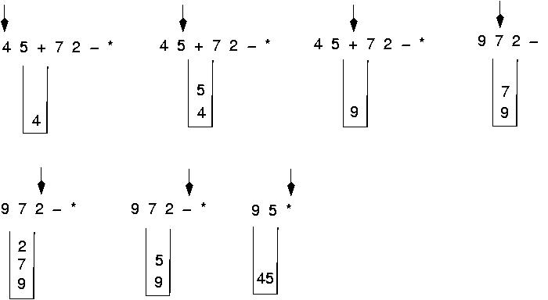
Evaluating a postfix Expression
Use a stack to evaluate an expression in postfix notation

Slide 25
Home Task
Write an algorithm to convert an infix expression to postfix and infix to prefix
Write an algorithm to evaluate a postfix and a prefix expression

